Slide 1




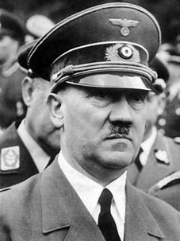
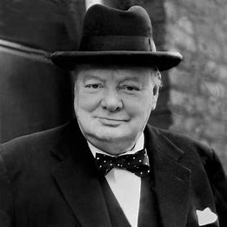
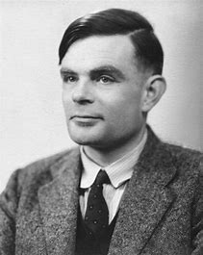
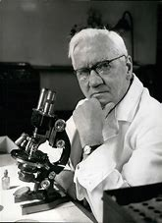
How are lives saved?
World War II
HISTORY KNOWLEDGE ORGANISER
Time Line of Key Events
Vocabulary Challenge
Allies | Countries who fought on the British side (including: USA, Great Britain, France, Russia (1941-1945))
Axis | Countries who fought on the German side (including: Italy, Germany, Japan, Russia (1939-1941))
Nazi Party | A German political party with racist and anti-Jewish ideas, led by Adolf Hitler
Czechoslovakia | A European country that no longer exists. Now forms two countries; The Czech Republic and Slovakia.
Propaganda | Information designed to promote a political idea or opinion.
Evacuee | Someone who was evacuated, moved from a danger area to a safer place (normally from the cities to rural areas).
Blitz | Series of aerial bombing raid on the UK, mainly on cities including London, Bristol, Coventry and Nottingham.
Radar | Radar is a system that uses waves of energy to sense objects. Helped to save many lives in the Second World War.
Enigma | A machine used by the Nazis to send coded messages.
Penicillin | An antibiotic produced naturally. Penicillin was discovered in 1928 and during the Second World War became the first antibiotic to be used.
Key Figures | A personal opinion on an aspect of geography, often linked to current affairs.
Adolf Hitler | Leader of the Nazi Party and Chancellor of Germany 1933-1945 – referred to as the Fuhrer meaning leader
1933 Adolf Hitler become chancellor of Germany
Radar
Invented
1935
1939-1945 World War II
May 1945 VE Day
1991 World Wide Web launched
AD 1900
1940 – Turing
Breaks the Enigma code
1928
Penicillin discovered
1st September 1939 – Germany invades Poland
December 1941 Japan bombs Pearl Harbour. USA join allies
AD 2000
August 1945
Atom bombs dropped on Japan. VJ Day 9th August
Adolf Hitler
Winston Churchill
Alan Turing
Alexander Fleming
The Outbreak of World War II
The leader of Germany, Adolf Hitler, had plans to take over other countries and expand his own power and Nazi Party. In March 1938, Germany, under the rule of Hitler, invaded and annexed Austria, which made other countries worried. On 29th September 1938, British, French, German and Italian leaders signed a treaty called the Munich Agreement. This allowed Hitler to annex (take over another country’s land and make it part of your country) the Sudentenland (an area of Czechoslovakia) if he agreed not to invade anywhere else. However, in August 1939, Hitler broke the agreement and invaded the rest of Czechoslovakia, followed by Poland on 1st September. Britain, France and Poland had made a pact to support each other so Britain and France declared war on Germany on 3rd September 1939.
Winston Churchill | UK Prime Minister, 1940-1945 (and again from 1951-1955)
Neville Chamberlain | UK Prime Minister 1937-1940 (infamous for failed attempts to satisfy Hitler’s demands prior to war)
Alan Turing | British mathematician who cracked the Enigma Code by inventing a machine called the Bombe. He worked at Bletchley Park with other code breakers.
Alexander Fleming | A Scottish physician and microbiologist who accidentally discovered Penicillin which has gone on to save millions of lives.

Slide 2
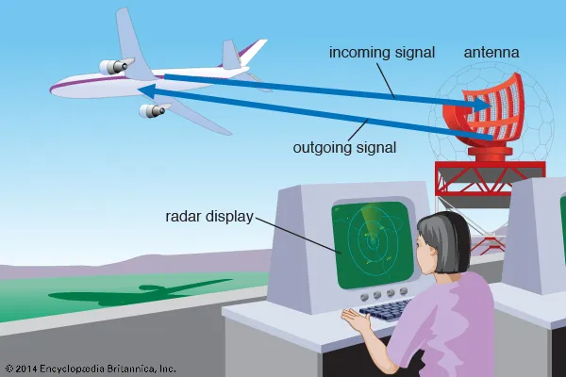
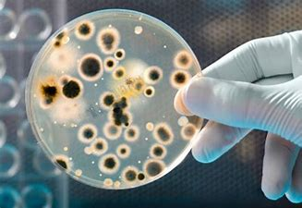
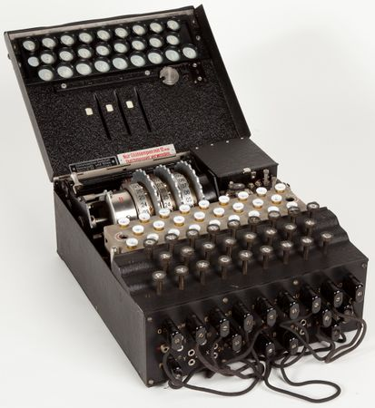
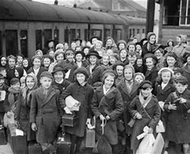
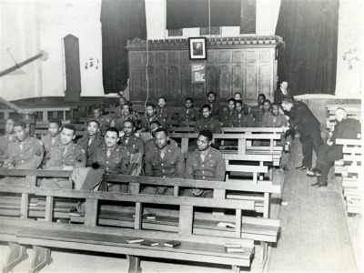
How are lives saved?
World War II
HISTORY KNOWLEDGE ORGANISER
Technological advances
Radar Radar is a system that uses waves of energy to sense objects. It can find a faraway object and tell how fast it is moving. Radar is very useful because it can sense objects even at night and through thick clouds. Work with radar started in the 1930s. A Scottish scientist named Robert Watson-Watt developed a radar system in 1935. It was used to help protect Great Britain from air attacks. During World War II (1939–45) radar helped Britain, France, and the United States defeat Germany. Since then many improvements have been made in radar technology. Today computers help radar systems provide more details about distant objects. Engima Machine The Enigma Machine was invented in Germany for the First World War but was of upmost importance in the Second World War. It was a cypher machine: a way of changing the letters of a message so that it appears to be scrambled letters (or, random letters) and puts the message into code. Each time a letter was typed, it appeared as another letter in the alphabet. The choices were not random. This gave the Germans a way of sending messages that the Allies could not understand and made their attacks unexpected. Working with other code breakers at Bletchley Park, Alan Turing, invented the Bombe machine, which was able to decipher the code so that the Allies could read the messages and be prepared for attacks.
Medical advances
Penicillin The discovery of penicillin was one of the greatest scientific achievements of the 1900s. Penicillin belongs to a group of medical drugs called antibiotics. These medicines fight infections caused by small living things called bacteria. In 1928 a Scottish doctor named Alexander Fleming discovered the effects of penicillin. During research on bacteria, Fleming noticed that the bacteria would not grow near a certain mold. He found that the mold was a type called Penicillium notatum. This mold is similar to the green fuzzy mold that grows on bread. From the mold Fleming developed the antibiotic now known as penicillin. During World War II in the 1940s, military doctors used penicillin to treat infected wounds. Thanks to penicillin, the death rate from pneumonia among soldiers dropped to less than one percent. Penicillin also saved the lives of many soldiers who might have died from wounds incurred during the D-Day invasion of 1944, and of course it has saved many millions of lives since.
Evacuation
Evacuation During World War II, over 3.5 million children, along with some of their teachers and helpers, mothers with very young children, pregnant women and people with disabilities, were evacuated from the cities to the countryside, where it was believed they would be safer from bombing. All evacuees had to take their gas mask, ration book and identity card. When they reached their destination, a billeting officer would arrange a host family for them. Evacuation happened in waves, beginning on 1st September 1939. Other waves occurred At the start of the Battle of Britain and at the start of the Blitz. Thousands of children evacuated to Devon with many arriving by train to Exeter and then moving on by bus to rural locations. Some of the children from London had never seen a cow before! Michael Aspel a famous news presenter was an evacuee and he quoted: ‘Homesickness! It was always there in the back of your mind, rather like a toothache that would never go away’
Countries working together
Black American GI’s in Exeter After the attack by the Japanese on Pearl Harbour in Hawaii, on December 7th 1941, the American’s joined World War II on the side of the Allies. They sent many troops to Britain to fight alongside the British soldiers. Some of the GI’s (General infantry) as the American Soldiers were known, were based in Exeter and among them were many Black soldiers. From 30 September 1943 to 30 June 1944 a number of African-American US troops units were based at the County Ground in St Thomas. Shockingly, during this time US Army had a policy of segregating black and white troops. In Exeter this meant that Black troops were based intents in County Ground, St Thomas and white soldiers were based in soldiers quarters at Topsham Barracks. Black soldiers were only allowed in certain parts of the city and not allowed to mix with the white soldiers or the community.

